Slide 1


DATA SCIENCE

Slide 2
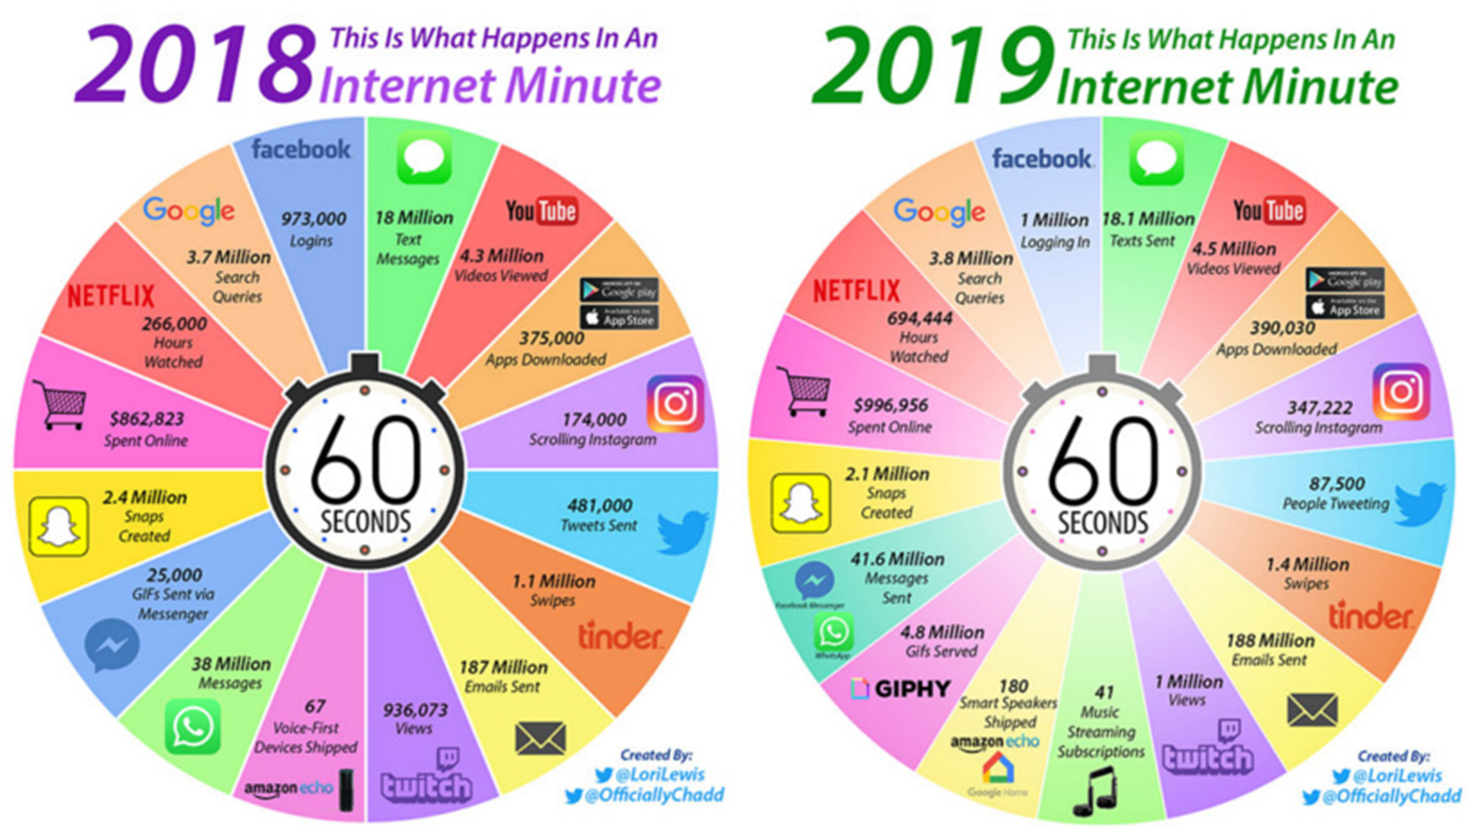

DATA

Slide 3
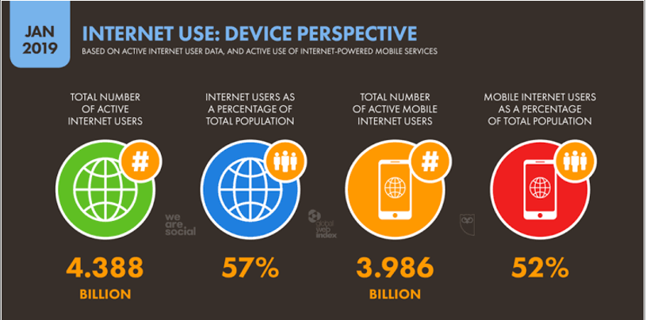

Slide 4

Data can be any character, number, images, word text which is raw and unorganized.
It can be considered as raw facts, which is input to the computer.
Whereas Information is created from data.
It is an output from a Computer
Data alone can never be significant. But information is always important by itself
DATA
Vs
Information

Slide 5
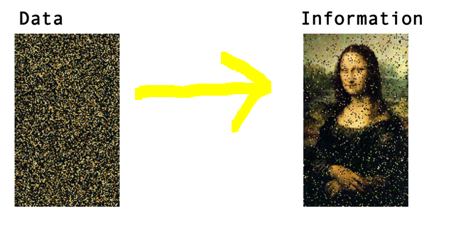

Slide 6
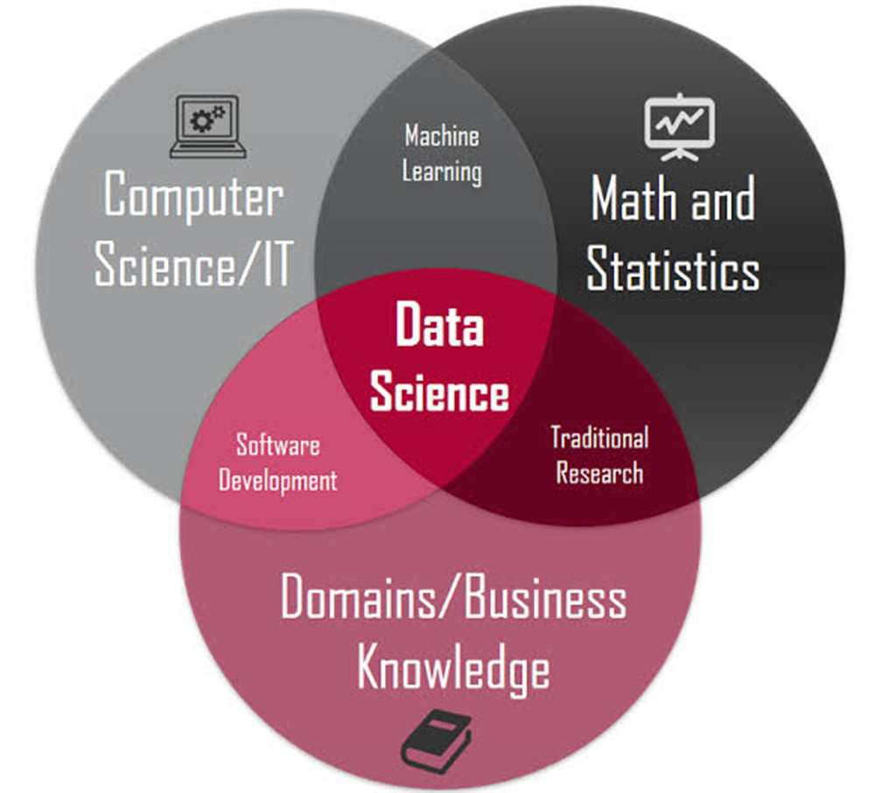
“”It is a multidisciplinary field to extract knowledge and insights from data.“”
“Data is like a crude and unpolished Diamond, which needs to be polished or cleansed for future use”
Notes:
Talk about the examples of Google 1998 and LinkedIn 2003 and also types of data and Starting with Dot Com Bubble, Big Data ,Cloud Computing,Data Science.

Slide 7
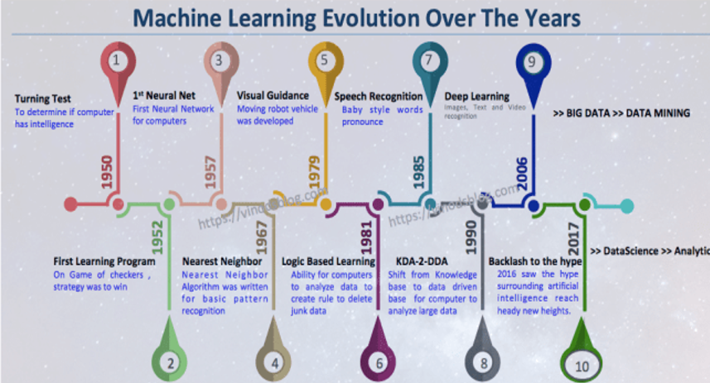
EVOLUTION
Notes:
Then there rose the fourth paradigm of “Science” which is Data Driven after Empirical, theoretical and Computational Science envisioned by Jim Gray in 2007(Turing Award) . In 2001 The term “Data Science” is
Coined by “William .S.Cleveland “in his article “An Action Plan for expanding the technical areas of the field of Statistics”.

Slide 8
22 years ago IBMs Deep Blue beat World Chess Champion Gary Kasparov, which marked the importance and gave people a serious attention.
Then in the 21st century everything has seen exponential growth in the development and applications.
2006 marked the word Deep Learning by publications made by Geoffrey Hinton from the concept of Deep Belief Nets.
2011 IBM Watson beat Human champions in Jeopardy.
Google started Brain Team and X Lab.
2014 FaceBook Face Tagging (DeepFace)
2016 Google’s Alpha Go beat Professional Players in Go game.
2017 - 2019 Self Driving Cars and Tensorflow influence.
ATTENTION
Notes:
Information is the Oil of 21st Century and Analytics is the combustion engine..Foundation itself laid in 18th and 19th centuries.It gained into fame with Alan Turing question “Can Machines Think”?

Slide 9

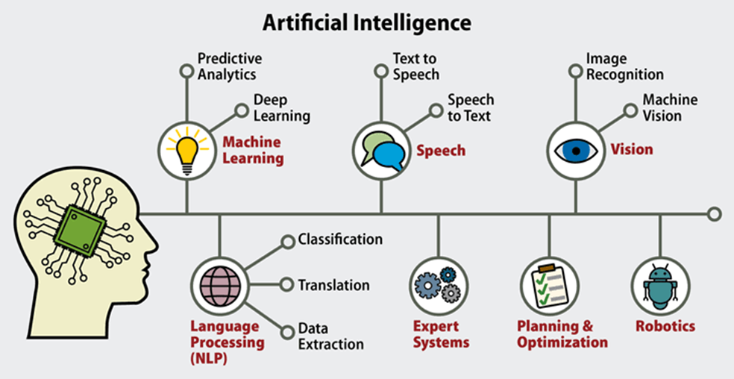
Data science is a concept used to tackle big data and includes data cleansing, preparation, and analysis. A data scientist gathers data from multiple sources and applies machine learning, predictive analytics, and sentiment analysis to extract critical information from the collected data sets.
Artificial Intelligence aims at enabling machines to execute reasoning by replicating human intelligence. Since the main objective of AI processes is to teach machines from experience, feeding the right information and self-correction is crucial.
AI experts rely on deep learning and natural language processing to help machines identify patterns and inferences.
Data Science
vs
Artificial Intelligence

Slide 10
Learning is the process of gaining information through observation.
More Learning, tasks can be performed more efficiently.
Types of Learning :
1.Expert Guidance
2.Knowledge gained from Experts
3.Self learning
Human Learning

Slide 11


Slide 12
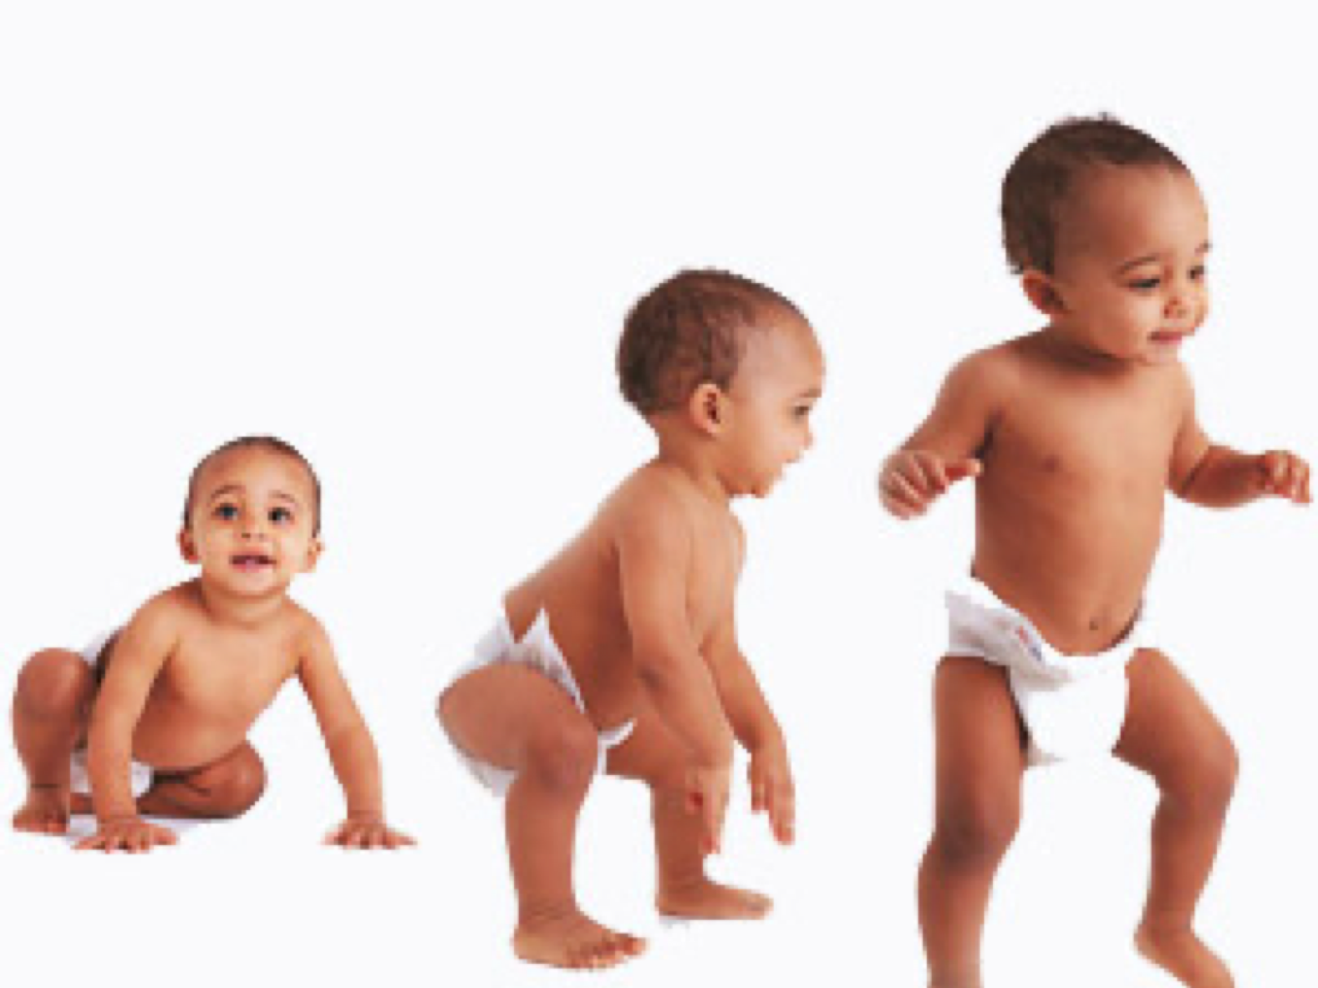

Slide 13


Slide 14


Slide 15
Generally confused with both of these terms
Making computers do the tasks we do.
Enabling the machine to do a particular task
Artificial Intelligence aims at enabling machines to execute reasoning by replicating human intelligence. Since the main objective of AI processes is to teach machines from experience, feeding the right information and self-correction is crucial.
ML is a subsection of Artificial intelligence that devices means by which systems can automatically learn and improve from experience.
ML
vs
AI
Notes:
Clearly differentiate between AI ,ML and DL,Computer Vision and Natural Language Processing.

Slide 16

MACHINE LEARNING

Slide 17
Has been in the picture from the past 50 years
Initially coined by Arthur Samuel in the year 1959 as Field of Study that gives computers the ability to learn without being explicitly programmed.
It was not that significant as of today 22 years ago.
Best definition by Tom Mitchell-A Computer Program is said to learn from experience "E" with respect to some class of tasks "T" and performance measure "P", If its performance at tasks in "T", as measured by "P", improves with experience "E".
HISTORY

Slide 18
Do Machines really learn?
How do they learn?
HOW?

Slide 19
Data Input :From the data we give, Past data for Future Decision Making
Abstraction: Data representation through underlying algorithm. Abstracting the Knowledge which comes as input data in form of model. Computational Blocks, Mathematical Equations, Specific Data Structures and Logical Groupings.
Generalization: Abstracted representation for making decisions.
LEARNING
Notes:
Best example with Human and Chappie Movie.

Slide 20
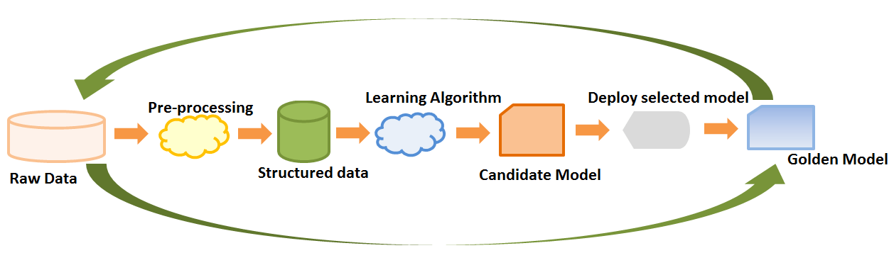

Slide 21
PROBLEM?
I need a program that will prompt the next word as and when I type a word.
T : Prompt the next word, when I type new word
E: A corpus of commonly used English words and phrases
P : The number of correct words prompted considered as a percentage(learning accuracy)

Slide 22

CNTD…
Similar Problems
What other problems have you seen or can you think of that are similar to the problem that you are trying to solve?

Slide 23
Does this problem solve any long standing business issues
Understand the benefits of solving the problem
Why does the problem need to be solved?

Slide 24

How would I Solve the problem?
Notes:
Think about our Manual step by step process of solving a problem starting with Data Collection,Data Preparation,Program design to solve the problem.No man is perfect the same is applicable for machines,human participation should also be added.

Slide 25
First Understand the type of data in the given input.
Explore the relationships amongst the data elements.
Find the potential issues in the data and do the necessary remediation.
Apply Preprocessing steps.
Once the data is prepared for modelling ,the input data is divided into two parts Training data and the Test data.
Train the model based on the training data for learning problems and the performance of the model is evaluated.
ACTIVITES

Slide 26
We divide Machine Learning into 6 jars. They are:
Data
Tasks
Model
Loss
Learning
Evaluation
6 JARS

Slide 27

Whether or not they are trained with human supervision.
Whether or not they can learn incrementally on the fly[Online vs Batch Learning]
Batch learning(Offline learning),the system is incapable of learning incrementally, it must be trained using all the available data, whereas Online Learning is not.
Whether they work by simply comparing new data points to known data points, or instead detect patterns [Instance based versus model based].
Learning by heart is Instance based learning, or building a model from the set of examples is Model Based Learning.
Types of Machine Learning Systems

Slide 28
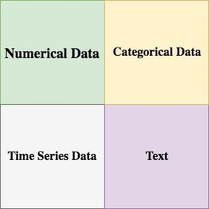
DATA
Data might be of any form.Broadly it is categorised as:
Qualitative(Categorical) and Quantitative(Numeric)
Nominal and Ordinal,Interval and Ratio.
Notes:
Nominal - no numeric such as Blood Group and Gender so no arithmetic operation only mode no other statistical functions.Ordinal is better or greater such as satisfaction very happy,sad and so on.Thus ordering is possible thus quartiles,mean is possible.Whereas for Numeric Interval and ratio arithmetic operations are possible.

Slide 29
A definition of what our inputs and outputs are.
Prediction
Classification
Generation
We mainly divide the dataset into two parts: train and test
At times we have Cross Validation set
TASK

Slide 30
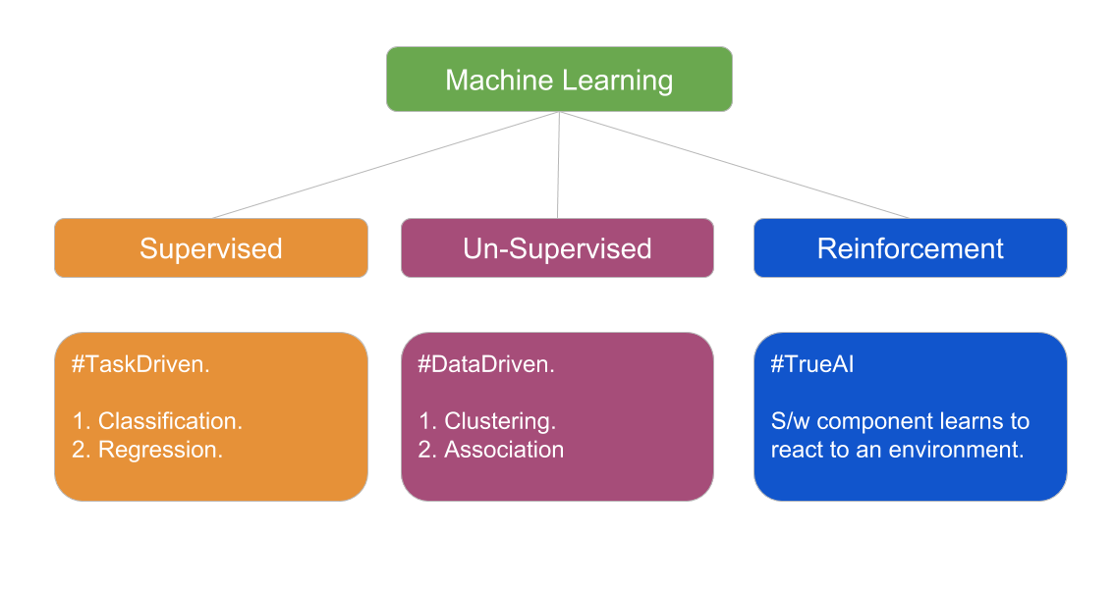

Slide 31
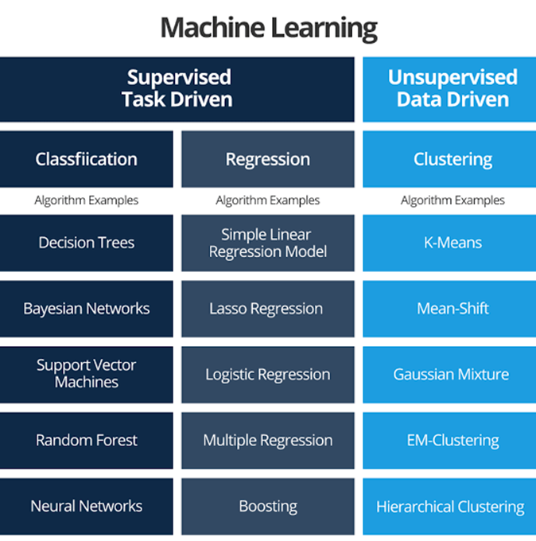

Slide 32

Supervised learning - Also called predictive learning. A machine predicts the class of unknown objects based on prior class-related information of similar objects.
Unsupervised learning - Also called descriptive learning. A machine finds patterns in unknown objects by grouping similar objects together, such as Clustering and Association Analysis.
Reinforcement learning - A machine learns to act on its own to achieve the given goals.
SUPERVISED LEARNING

Slide 33
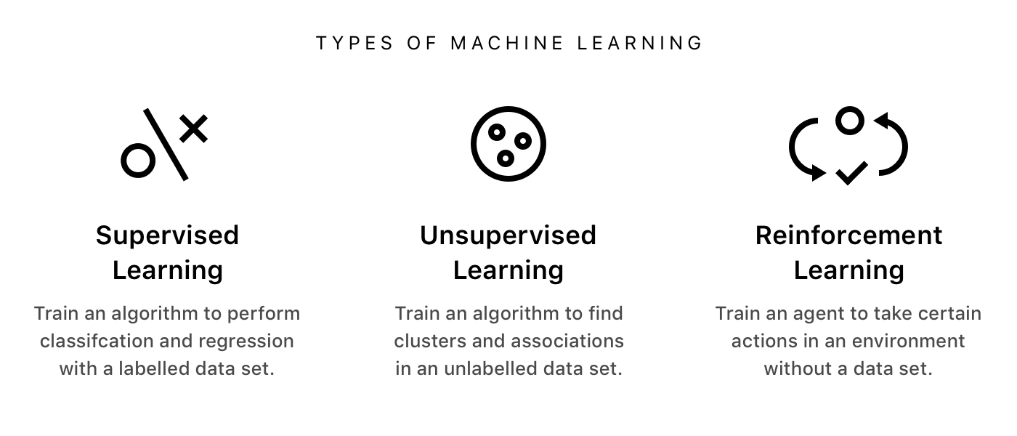

Slide 34
Predicting the results of a game
Predicting whether a tumour is malignant or benign
Predicting the price of domains like real estate, stocks, etc
Classifying texts such as classifying a set of emails as spam or non-spam
SUPERVISED LEARNING

Slide 35
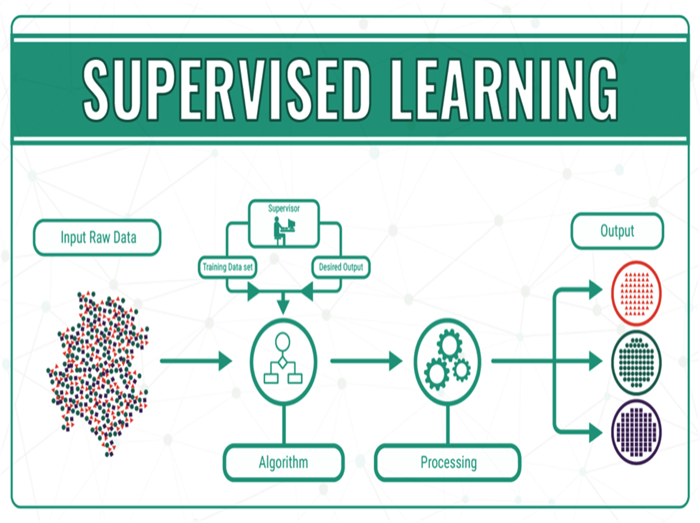

Slide 36

Finding patterns in the unknown objects by grouping similar objects.
Also called as Descriptive Learning
No labels
Clustering,Association Analysis
UNSUPERVISED LEARNING

Slide 37
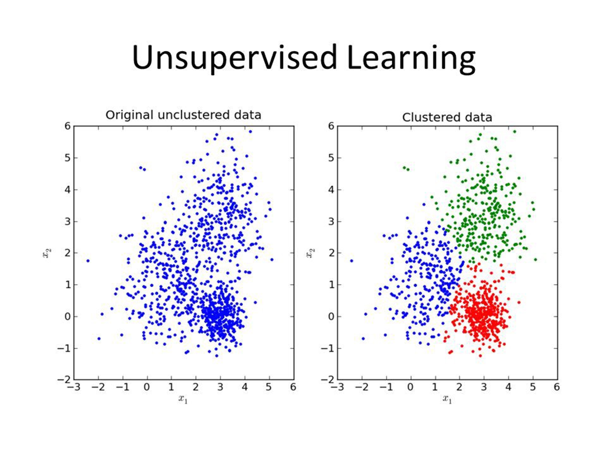

Slide 38
Goal-oriented algorithm
Learns to act on its own to achieve given goals
They can start from a blank slate, and under the right conditions they achieve superhuman performance.
Self-Driving Cars, Intelligent Robots, AlphaGO Zero(latest version of Google’s Deep Mind)
REINFORCEMENT LEARNING

Slide 39
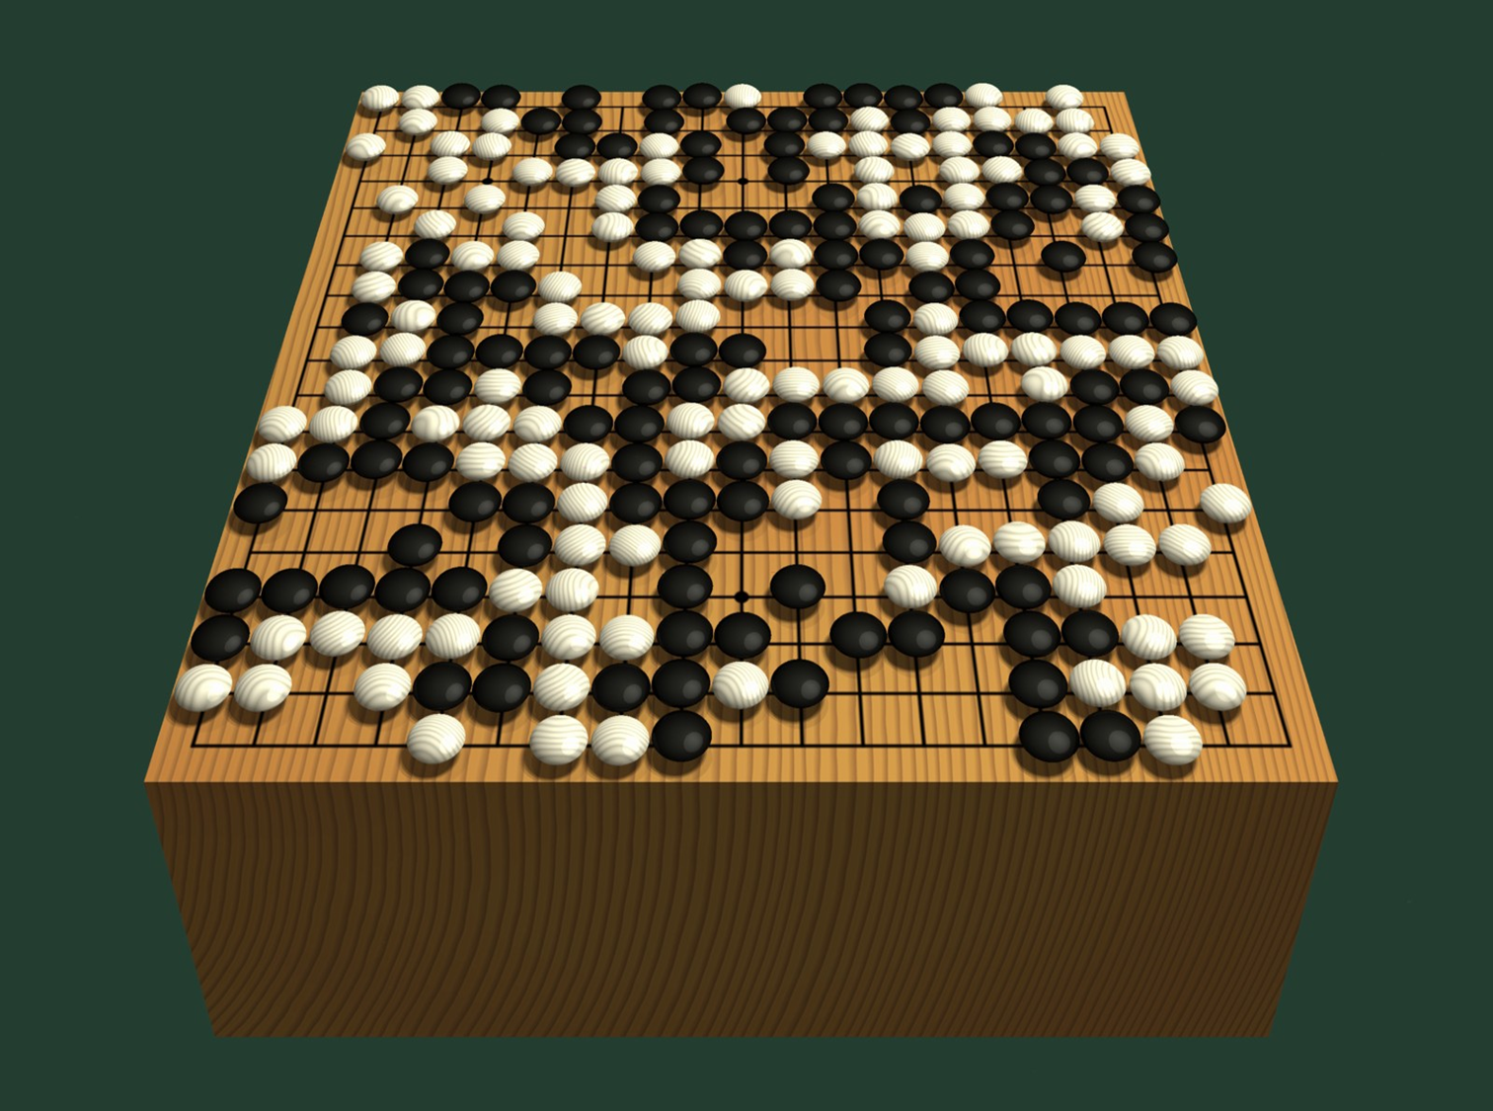

Slide 40
DeepMind
The first computer program to defeat a world champion at the ancient Chinese game of Go
Arguably the strongest Go player in history.
Previous versions of AlphaGo initially trained on thousands of human amateur and professional games to learn how to play Go
Zero skips this step and learns to play simply by playing games against itself, starting from completely random play.
AlphaGo Zero

Slide 41
Loss functions are very important.
Measured during our training
A measure of error
Intuitions about our model
Some common loss functions:
MSE
Cross entropy loss
KL divergence
LOSS

Slide 42
We are done with training
We see how good our model is.
Different Evaluation metrics:
F1 score
Precision and Recall
Accuracy
Confusion matrix
Evaluation

Slide 43


Confusion Matrix

Slide 44
CNTD…
The model predicted win and the team won (TP)
The model predicted win and the team lost(FP)
The model predicted loss and the team won(FN)
The model predicted loss and the team lost(TN)

Slide 45
Model accuracy = TP+TN / TP+FP+FN+TN
Actual win Actual loss
Predicted win 85 4
Predicted loss 2 9
Precision = TP / TP + FP
Recall = TP / TP + FN
F-Measure = 2 * Precision * Recall / Precision + Recall
Model Accuracy

Slide 46
Machine learning saves life - ML can spot 52% of breast cancer cells, a year before patients are diagnosed
US Postal Service uses machine learning for handwriting recognition
Facebook’s news feed uses machine learning to personalise each members feed.
Uttar Pradesh has deployed AI-enabled video analytics platform “Jarvis” in 70 prisons to monitor inmates.
Did you know?

Slide 47
CNTD…
ML should not be applied to tasks in which humans are very effective or frequent human intervention is needed.
For example, air traffic control is a very complex task needing intense human involvement.
For very simple tasks which can be implemented using traditional programming paradigms, there is no sense of using machine learning.
For example, formula-based applications like price calculator engine, dispute tracking applications.

Slide 48
CNTD…
where training data is not sufficient, machine learning cannot be used effectively. This is because, with small training data sets, the impact of bad data is exponentially worse.
For the quality of prediction or recommendation to be good, the training data should be sizeable.

Slide 49

It's possible to build DL solutions from scratch, DL frameworks are a convenient way to build them quickly
Provides different neural network architectures out of the box in popular languages so that developers can use them across multiple platforms
Tensorflow, keras, Mxnet, PyTorch etc.
FRAMEWORK

Slide 50

Anaconda to be installed
Spyder or Jupyter Notebook
Important packages in python:
Scikit-learn
Numpy
OpenCv
Pandas
Scipy
Dlib
Tensorflow and Keras
Software
Requirement

Slide 51
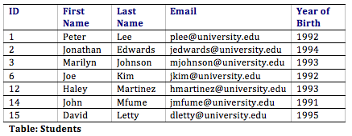
Attributes can also be termed as Feature, Variable, Dimension or Field
Notes:
Pandas importance and data cleansing.

Slide 52
Feature Engineering - Translating a dataset into features which will be able to represent the dataset more effectively.
1)Feature Transformation
2)Feature Subset-selection.
Feature Transformation - Transforms the data- structured or unstructured into a new set of features.
1)Feature Construction
2)Feature Extraction.
It intends to select a subset of system attributes which makes a most meaningful contribution in a machine learning activity.
High dimensional refers to the high number of variables or attributes present in certain datasets, thus based in Feature relevance and Feature redundancy we select the dataset.
Feature Engineering

Slide 53
Get the data (real world data)
Discover and visualize the data to gain insights.
Prepare the data for Machine Learning algorithms
Select a model and train it.
Fine tune your model
Present your solution
Launch,Monitor and maintain your system.
Main steps to follow

Slide 54
Scikit-Learn’s API is remarkably well designed.The main design principles are :
1)Consistency - Estimators (fit()),Transformers (fit_transform()) and Predictors (predict() and score()) methods.
2)Inspection - Estimators hyper-parameters.
3)Nonproliferation of classes.
4)Composition - To create a Pipeline Estimator.
5)Sensible defaults - Reasonable default values for most parameters.
Scikit-Learn Design

Slide 55
Linear Regression - Simplest Regression Model which gives the relationship between dependent and independent variables.Two different ways to train :
1) It uses a direct “closed form” equation that directly computes the model parameters that best fit the model to the training set.
2) Iterative optimization approach called “Gradient Descent” which tweaks the model parameters to minimize the cost function.
Regression Models
Notes:
Cost Function (Error Function) helps to measure the extent to which the model is going wrong in estimating the relationship between X and Y.

Slide 56
It can fit non linear datasets as it has more parameters than Linear Regression, it is more prone to overfitting the training data.
The simple way to do this is to add power of each feature as new features, then train a linear model on this extended set of features.
Thus it is called as Polynomial Regression.
Polynomial Regression

Slide 57
Logistic Regression - It is commonly used to estimate the probability that an instance belongs to a particular class or not.
If the estimated probability is greater than 50% then the model predicts that the instance belongs to that class (called Positive class, labelled “1”),or else it predicts that it does not (belongs to negative class ,labelled “0”).
The logistic Regression model can be generalized to support multiple classes directly, without having to train and combine multiple binary classifiers.This is called Softmax Regression or Multinomial Logistic Regression.
Commonly Used Classification Tasks

Slide 58
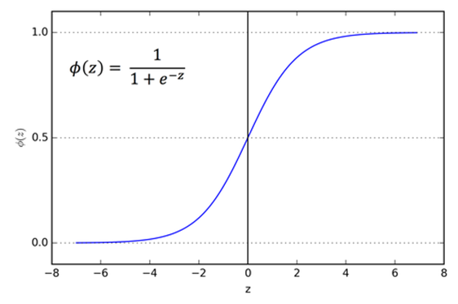
Sigmoid Curve

Slide 59
Decision Tree- One of the most widely adopted algorithms for classification. As the name indicates it builds a model in the form of a tree structure. It is used for Multi-dimensional analysis with multiple classes.It is characterized by fast execution time and ease in the interpretation of the rules.
Each node (or decision node) corresponds to one feature vector.
It consists of three types of nodes
Root Node,Branch Node,Leaf Node
Tree Based Methods

Slide 60
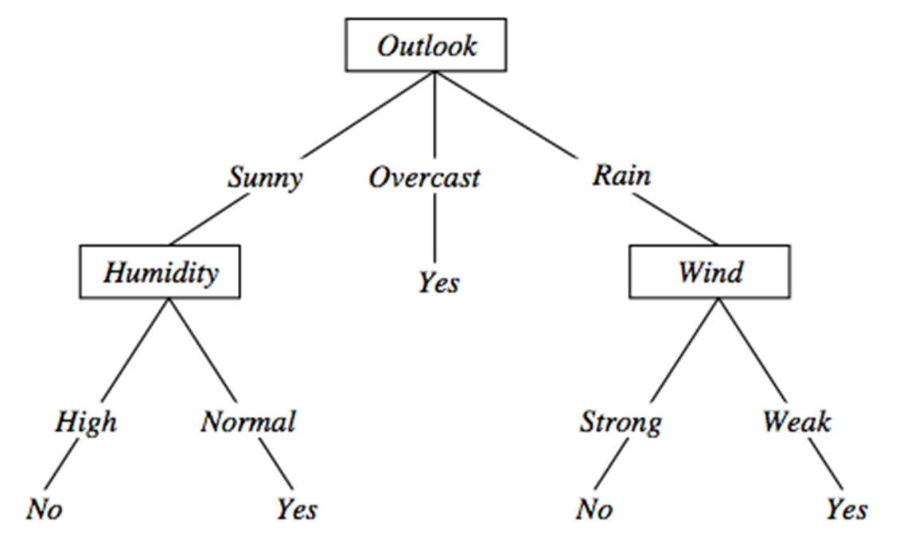
Sample Tree

Slide 61
CART (Classification and Regression Trees) — This makes use of Gini impurity as metric.
Gini(E) = 1 - Σj = 1 to c p^2 j
ID3 (Iterative Dichotomiser3) — This uses entropy and information gain as metric.
Entropy(S) = -P(yes)log2P(yes) – P(No)log2(No)
Information Gain = Entropy(S) – [(Weighted Avg)*Entropy(each feature)]
Algorithms to build
D-Tree

Slide 62
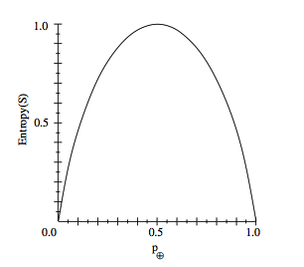
Entropy

Slide 63
The Decision Tree algorithm,unless a stopping criterion is applied, may keep growing indefinitely.
Thus Splitting for every feature and dividing into smaller partitions till the point that data is classified.
This is done by Pruning which is reducing the size of the Decision Tree.
Pre-Pruning and Post-Pruning
Overfitting

Slide 64
Random Forests: It is an Ensemble Classifier,as it is combination of many Decision Tree Classifiers. Ensembling is usually done using the concept of bagging with different feature sets.
It runs very efficiently and blindly we can choose Random Forest Algorithm for any large and expensive data sets.
Tree Based Methods

Slide 65
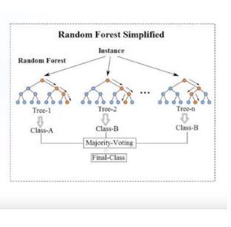
Implementation
Notes:
Talk about the example of Movies Tom Cruise

Slide 66
Support Vector Machines: It is a model, which can do linear classification as well as Regression.
We can use algorithm to create hyperplanes in space that separate the data, guided by the labels that we have.
Hyperplane is the generalization of a plane.
i.In one dimension, a hyperplane is called a point
ii.In two dimensions, it is a line
iii.In three dimensions, it is a plane
iv.In more dimensions you can call it a hyperplane
Support Vector Machines
Notes:
Talk about Farm example

Slide 67
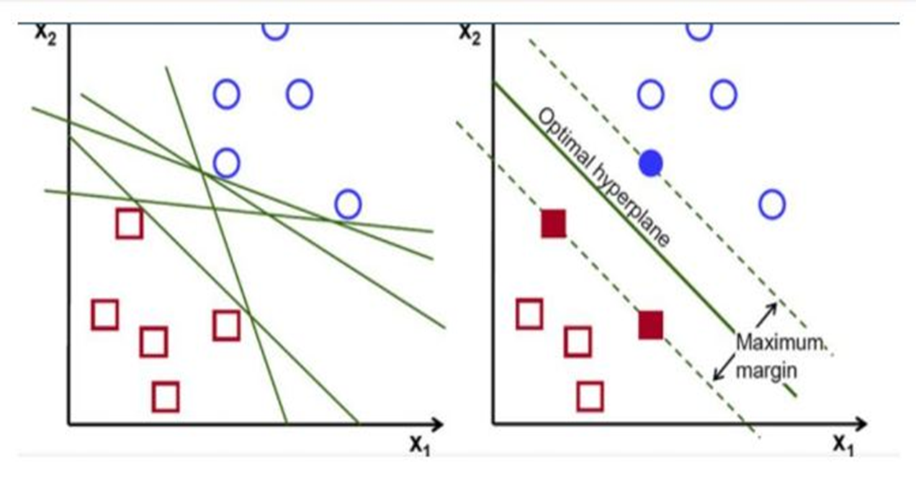
Implementation
Notes:
Talk about the example of Movies Tom Cruise

Slide 68
Support vectors are data points that are closer to the hyperplane and influence the position and orientation of the hyperplane. Using these support vectors, we maximize the margin of the classifier.
Deleting the support vectors will change the position of the hyperplane.These are the points that help us build our SVM.
Results are very promising and can be used for both regression and classification, not much interpreted with noise.Such as in Binary Classification of images into face and non face components.
Support Vectors

Slide 69
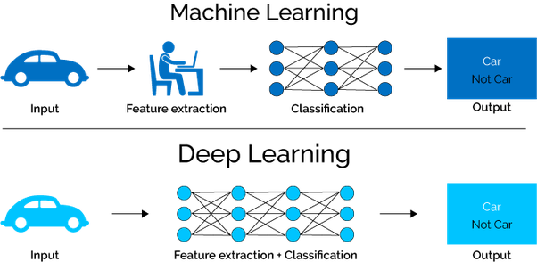
ML → DL
Notes:
Talk about the example of Movies Tom Cruise

Slide 70

EXAMPLE

